Slide 1
North Country Health Consortium
Leading innovative collaboration to improve the health status of northern New Hampshire

Slide 2
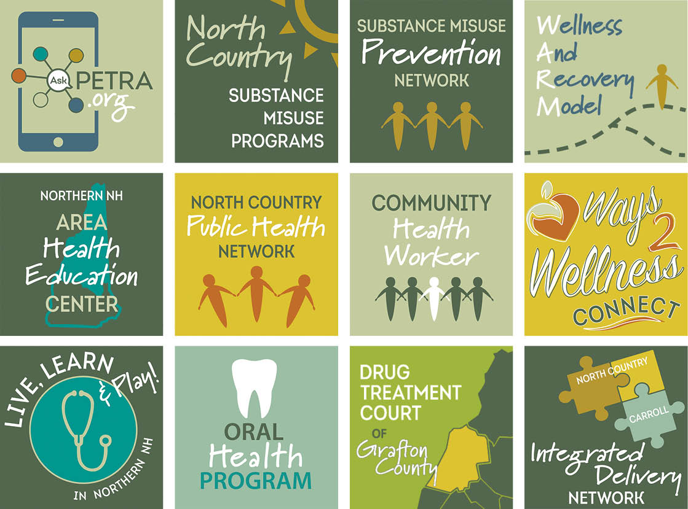

Slide 3
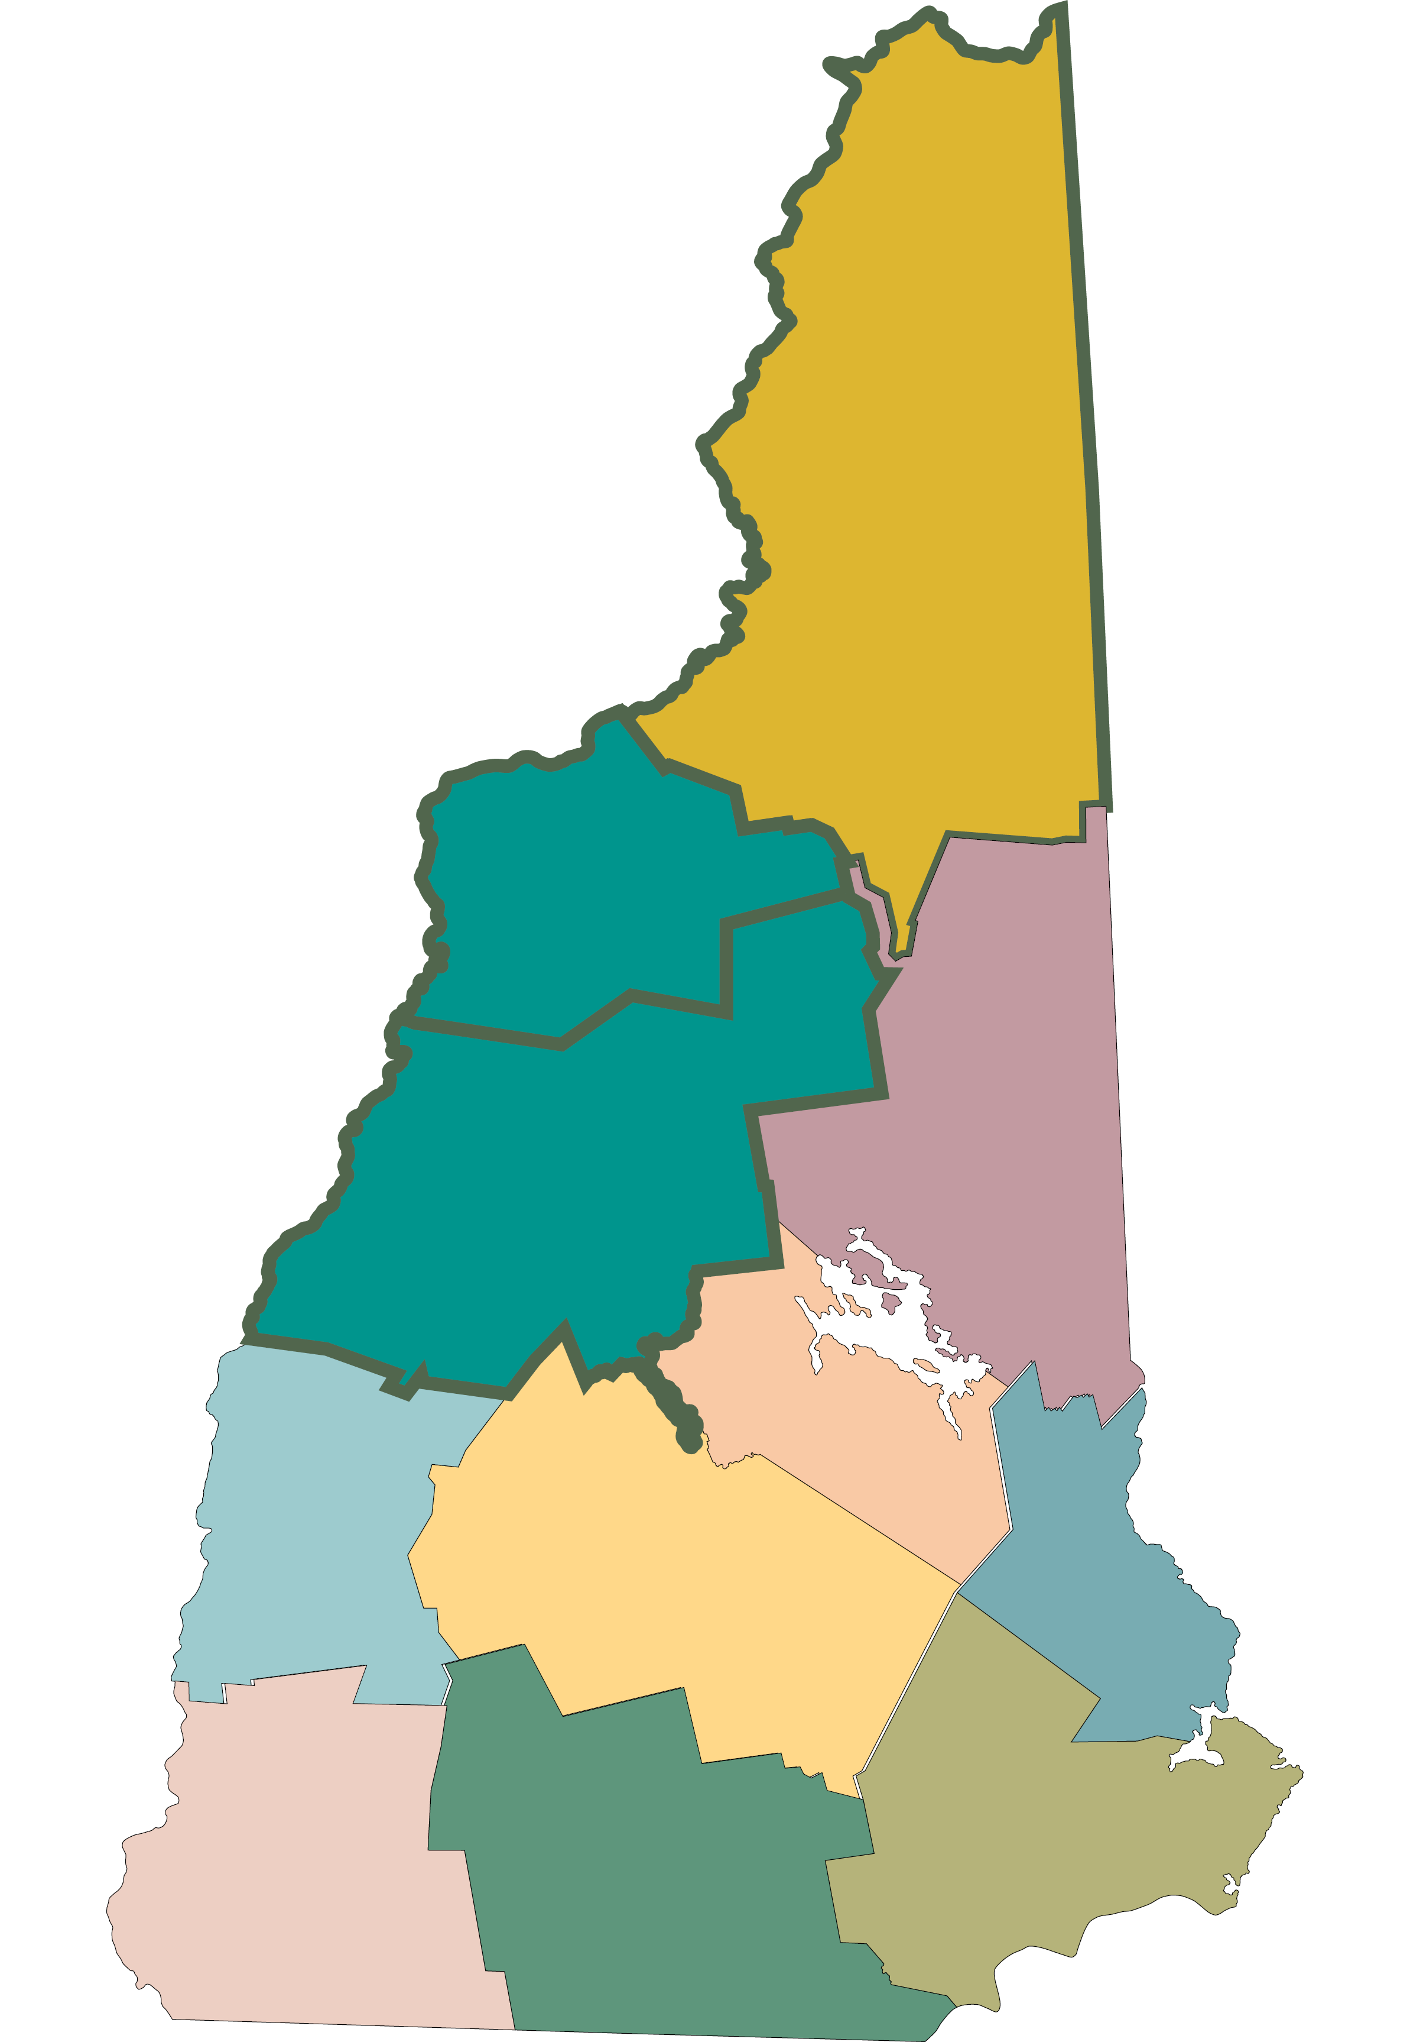
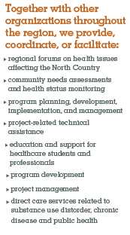

Slide 4
2003: To assure an accessible, cost-effective, responsive and quality health care for individuals in the North County.
2021: Leading innovative collaboration to improve the health status of Northern New Hampshire.

Slide 5
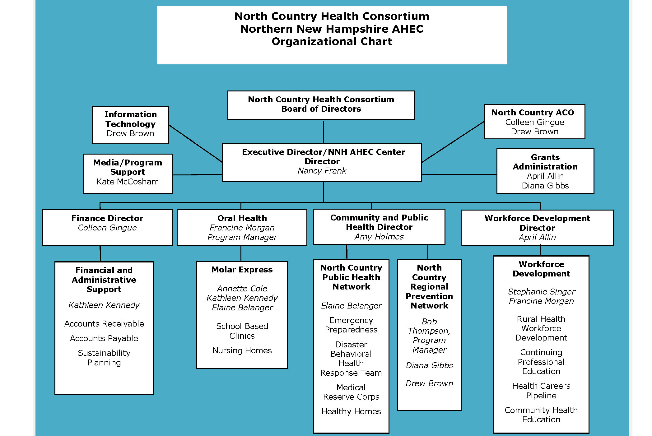
Organizational Chart “THEN” circa 2012
1.9 million
In Revenue
13 staff

Slide 6
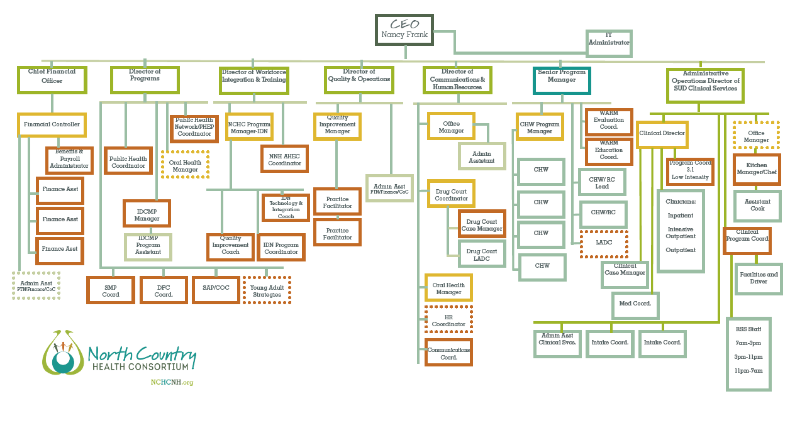
Organizational Chart circa 2019
75 staff
30 SUDCS staff

Slide 7
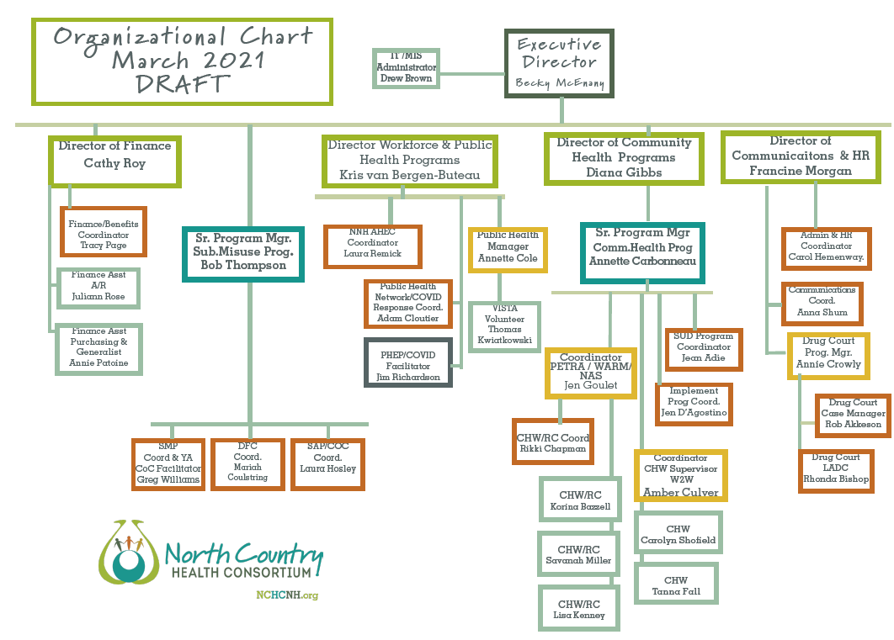
ORGANIZATIONAL CHART “NOW”
35 staff
25% of staff have started a new position within the last 90 days.
80% of Senior Staff have a new role.

Slide 8
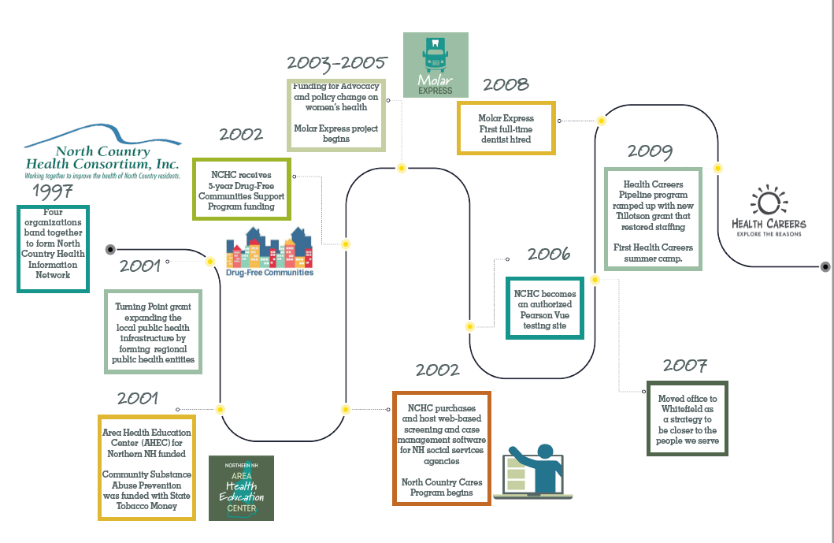
NCHC Timeline 1997-2009
1-12 employees

Slide 9
Timeline 2010-2016
12-16 employees

Slide 10
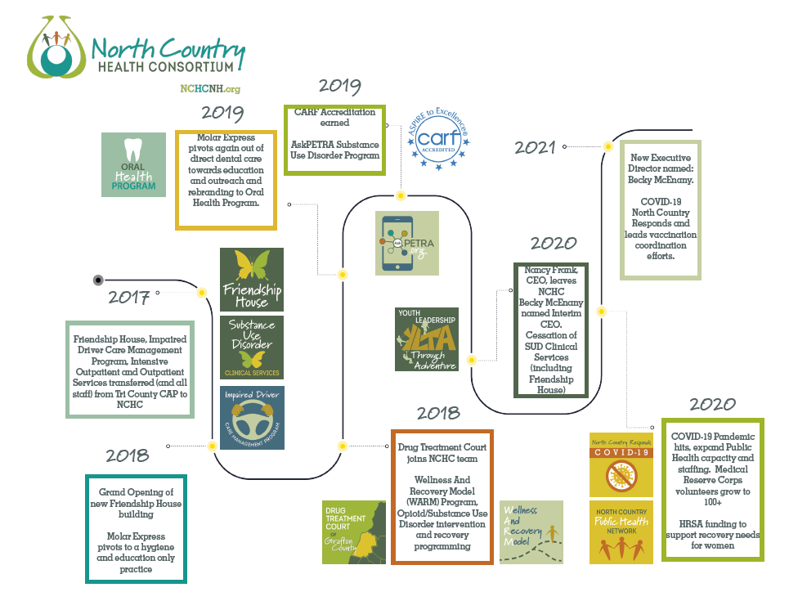
Timeline 2017-2021
16 --34 -- 75 -- 35 employees

Slide 11
NCHC Program Areas

Slide 12
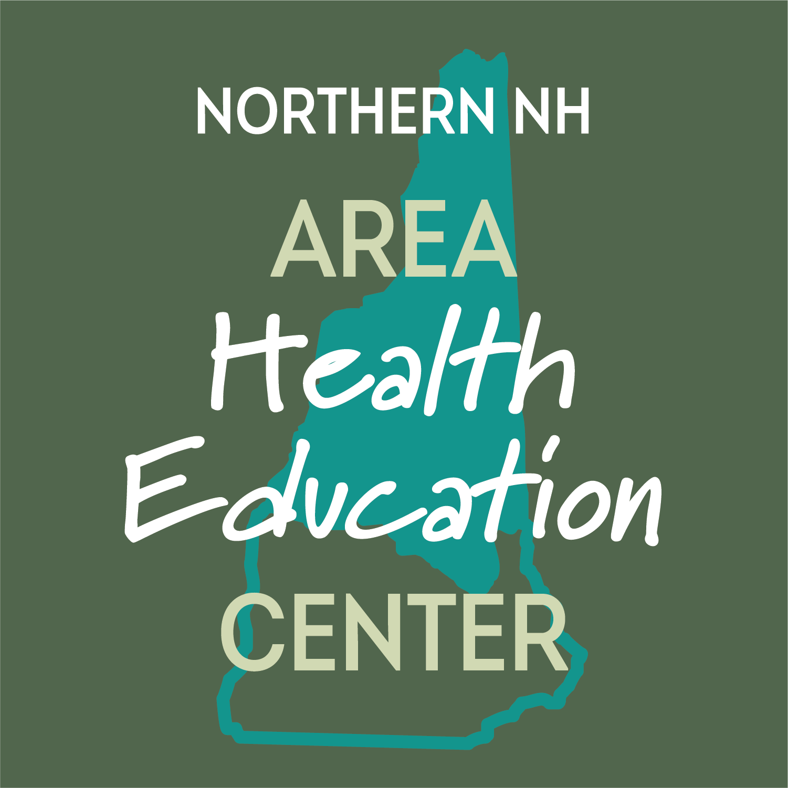
Northern New Hampshire Area Health Education Center (NNH AHEC) Established in April 1999
Connecting students to careers, professionals to communities, and communities to better health
One of 2 federally designated AHEC centers in NH and is affiliated with the AHEC program at The Dartmouth Institute. NNH AHEC serves Coos, Carroll, Grafton and Belknap counties.

Slide 13
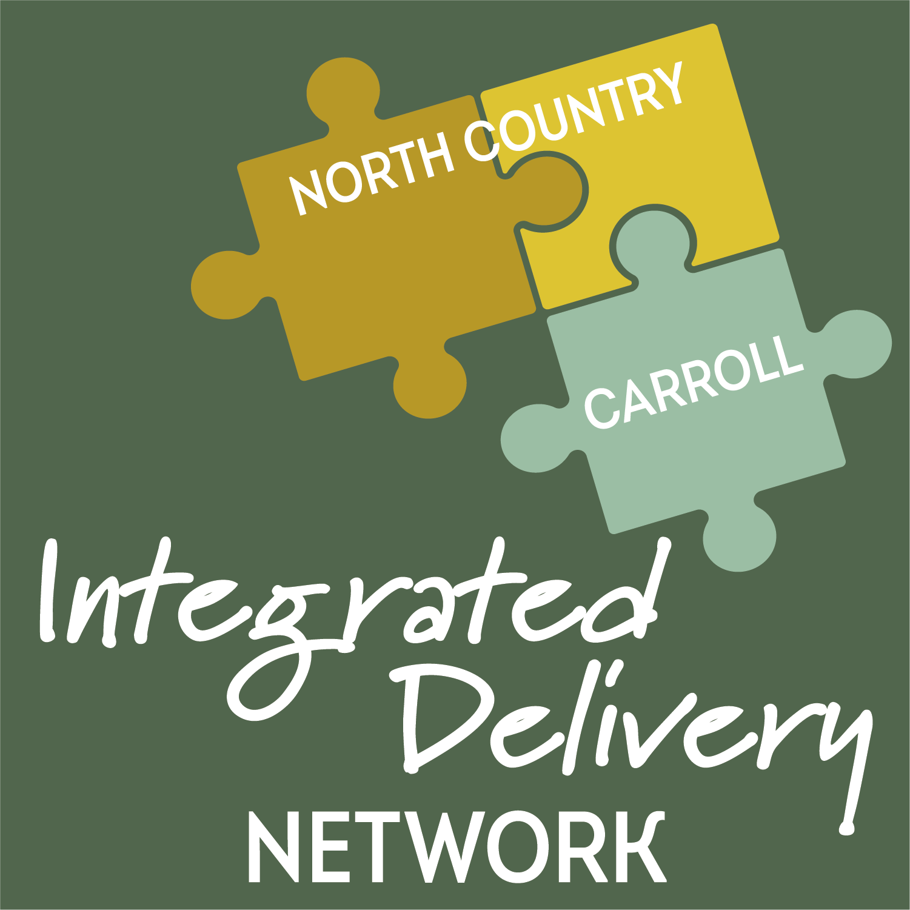
Region 7 Integrated Delivery Network January 2016-December 31, 2020
Delivery System Reform Incentive Program (DSRIP) is 5-year Medicaid waiver for a statewide Demonstration project to transform the State’s behavioral health delivery system to help improve care and slow long-term growth in health care costs.
NCHC is the Administrative Lead Agency of the Region 7 Integrated Delivery Network which serves Coos, Carroll, and northern Grafton County
Winding down. Some funding will continue through 2022.

Slide 14
Public Health
North Country Public Health Network serves Coos and Northern Grafton County
Public Health Emergency Preparedness
Healthy Homes and Environments
Social Determinants of Health
Oral Health
Chronic Disease
Medical Reserve Corps
Substance Misuse
Notes:
Quick consortium overview? , the Consortium seeks to meet the unmet health related needs of our region.
Some of those areas include:
Healthcare workforce shortage
Gaps in the continuum of care for those unable to navigate the complexities of the healthcare system
High ED utilization
Need to address essential Social Determinants of Health
Rural health disparities – ( such as geographic isolation, lower social-economic status, higher rates of behaviors that contribute to chronic disease, older population, less likely to have employer paid healthcare.)

Slide 15
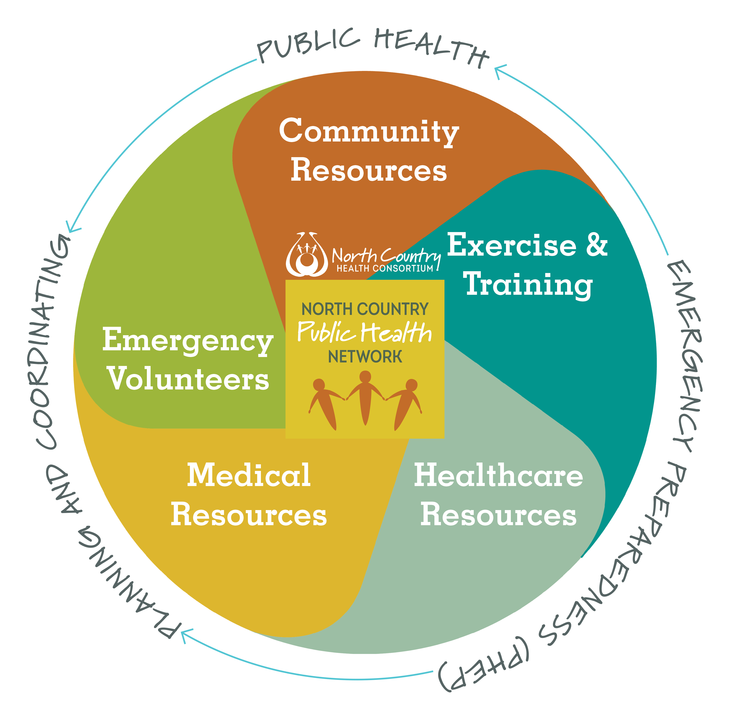
Public Health
Assessing community health needs and facilitating the regional Community Health Improvement Plan (CHIP) by coordinating and collaborating with partners in all sectors.
Notes:
Quick consortium overview? , the Consortium seeks to meet the unmet health related needs of our region.
Some of those areas include:
Healthcare workforce shortage
Gaps in the continuum of care for those unable to navigate the complexities of the healthcare system
High ED utilization
Need to address essential Social Determinants of Health
Rural health disparities – ( such as geographic isolation, lower social-economic status, higher rates of behaviors that contribute to chronic disease, older population, less likely to have employer paid healthcare.)

Slide 16
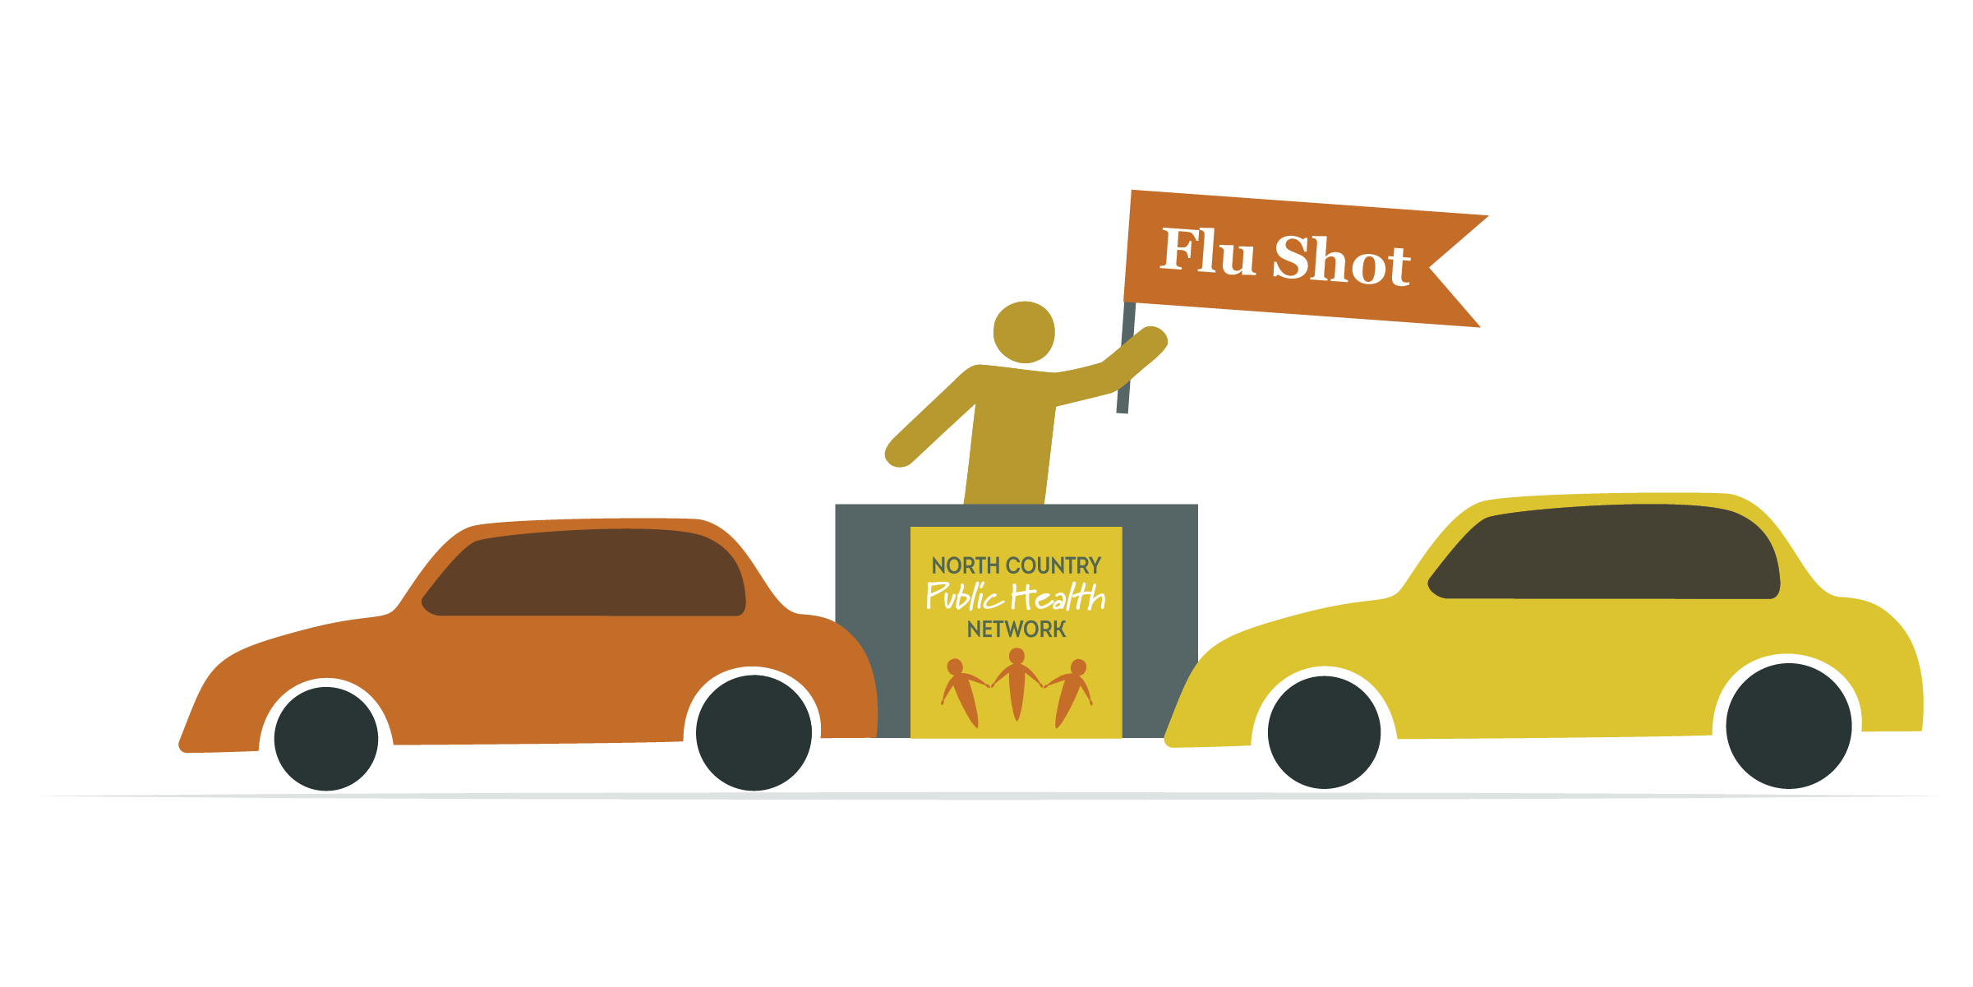
Public Health Response
Notes:
Quick consortium overview? , the Consortium seeks to meet the unmet health related needs of our region.
Some of those areas include:
Healthcare workforce shortage
Gaps in the continuum of care for those unable to navigate the complexities of the healthcare system
High ED utilization
Need to address essential Social Determinants of Health
Rural health disparities – ( such as geographic isolation, lower social-economic status, higher rates of behaviors that contribute to chronic disease, older population, less likely to have employer paid healthcare.)

Slide 17
Public Health Emergency
Notes:
Quick consortium overview? , the Consortium seeks to meet the unmet health related needs of our region.
Some of those areas include:
Healthcare workforce shortage
Gaps in the continuum of care for those unable to navigate the complexities of the healthcare system
High ED utilization
Need to address essential Social Determinants of Health
Rural health disparities – ( such as geographic isolation, lower social-economic status, higher rates of behaviors that contribute to chronic disease, older population, less likely to have employer paid healthcare.)

Slide 18
Public Health: Oral Health
Oral Health Program:
Certified Public Health Dental Hygienist provides oral health services and dental education for children through age 5 in Coos and Northern Grafton Counties, and connects families to dental homes
Provide outreach and education with the goal of oral health for overall health

Slide 19
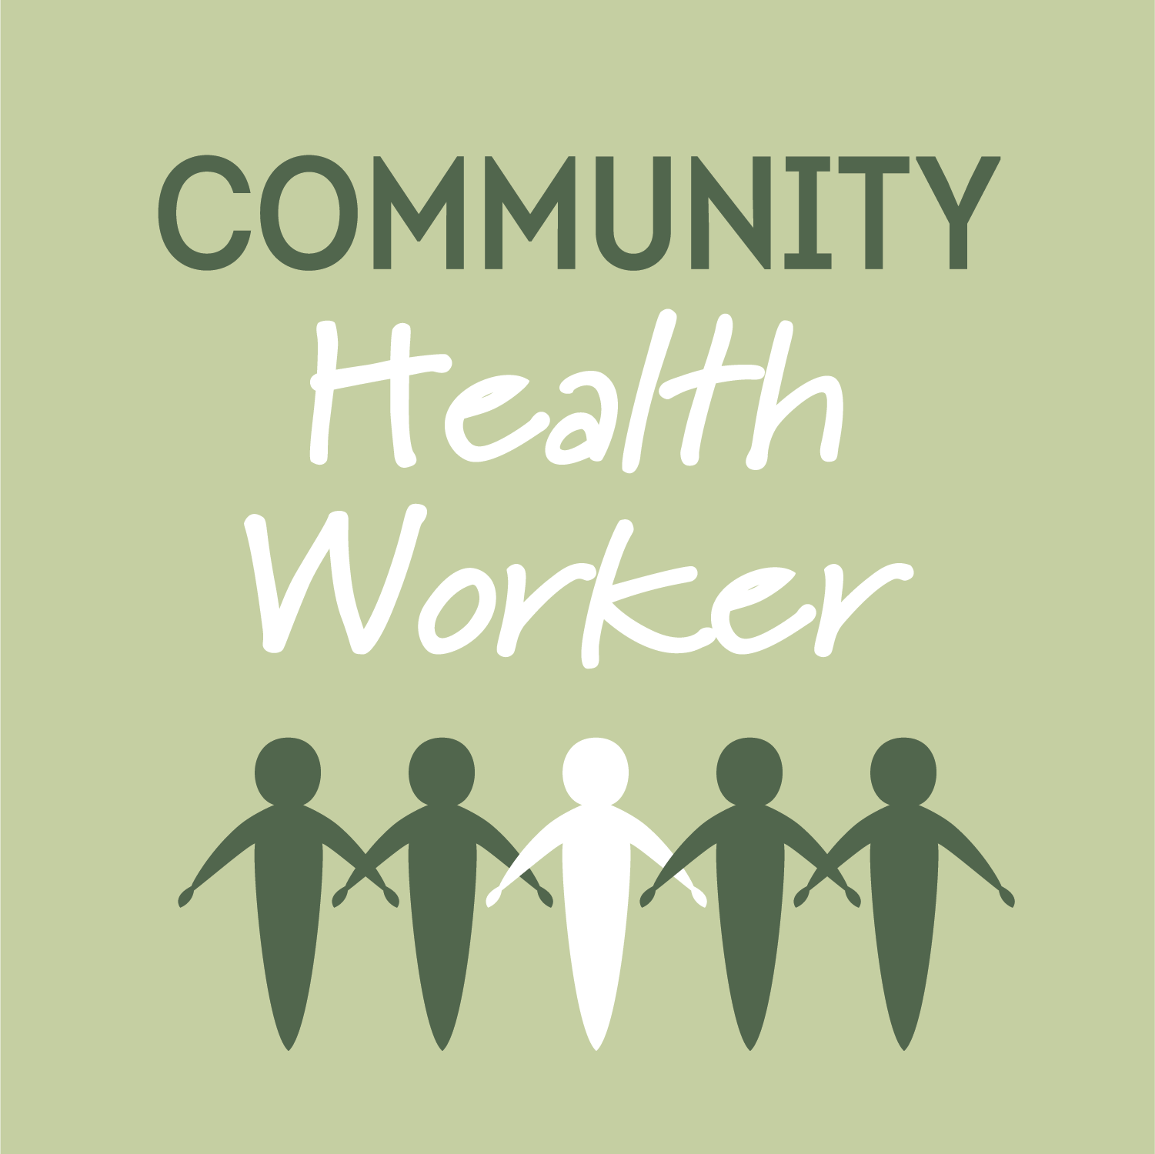
Community Health Workers
“A community health worker is a frontline public health worker who is a trusted member of and/or has an unusually close understanding of the community served.”
-American Public Health Association
Liaison
Link
Intermediary

Slide 20
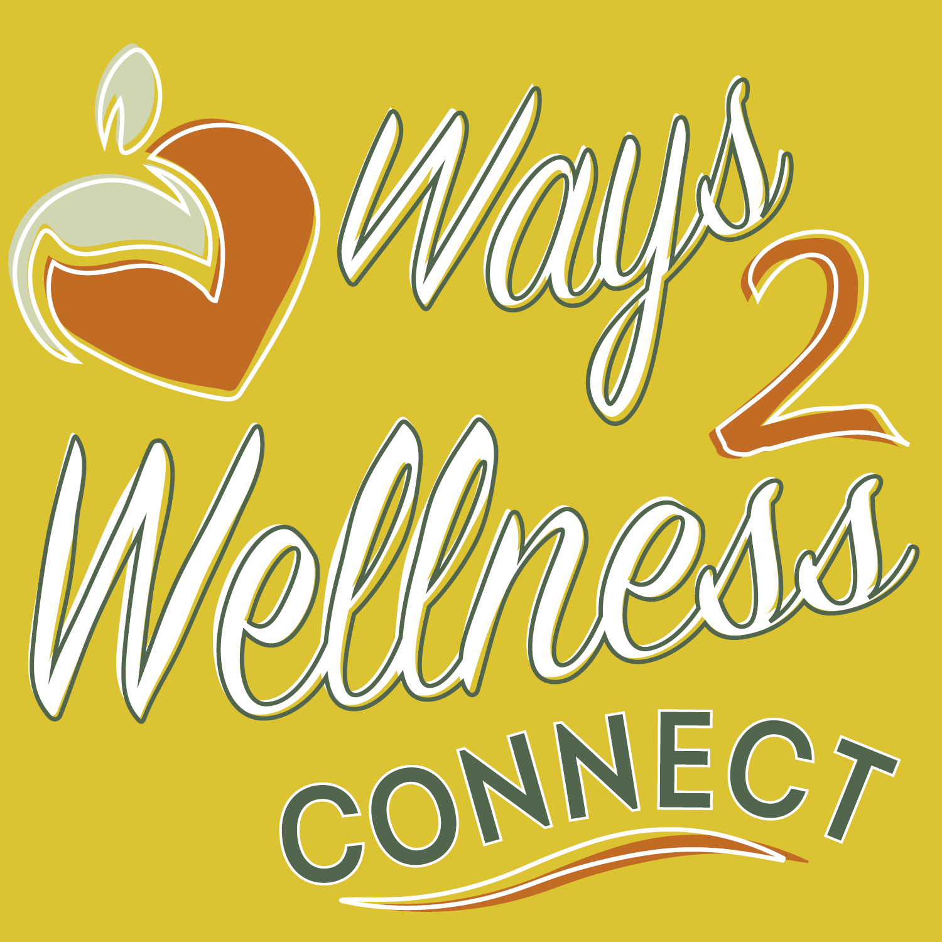
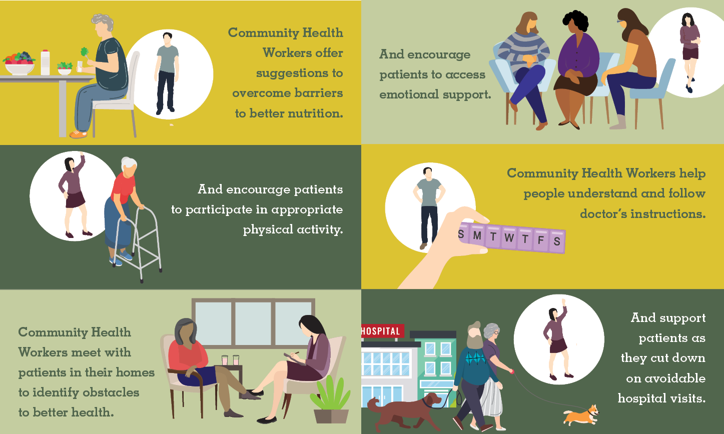
Ways 2 Wellness Connect
What is Ways2Wellness CONNECT?
The Ways2Wellness CONNECT Program links Community Health Workers (CHWs) with community partners to link patients who are struggling with unmanaged chronic disease and experiencing barriers to achieving overall health and wellness.
The program currently works with patients ages 55 and over with unmanaged chronic disease, such as hypertension, diabetes, congestive heart failure, Congestive Obstructive Pulmonary Disorder (COPD), etc. at no cost to the patient or provider.

Slide 21
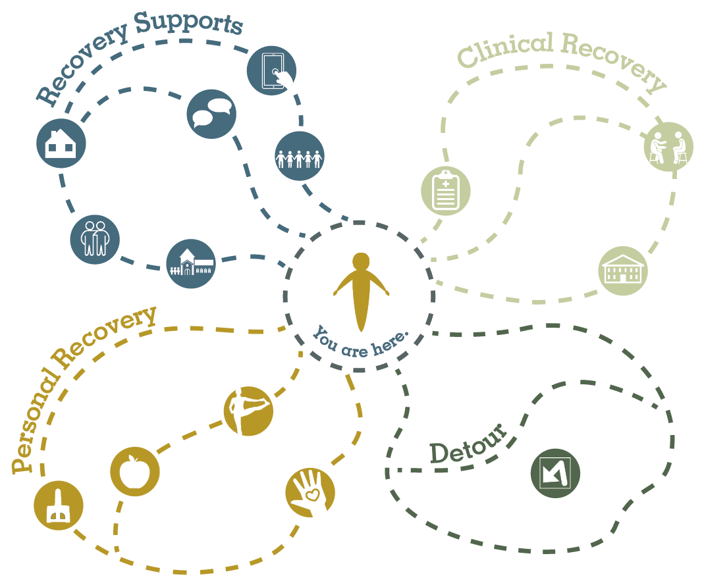
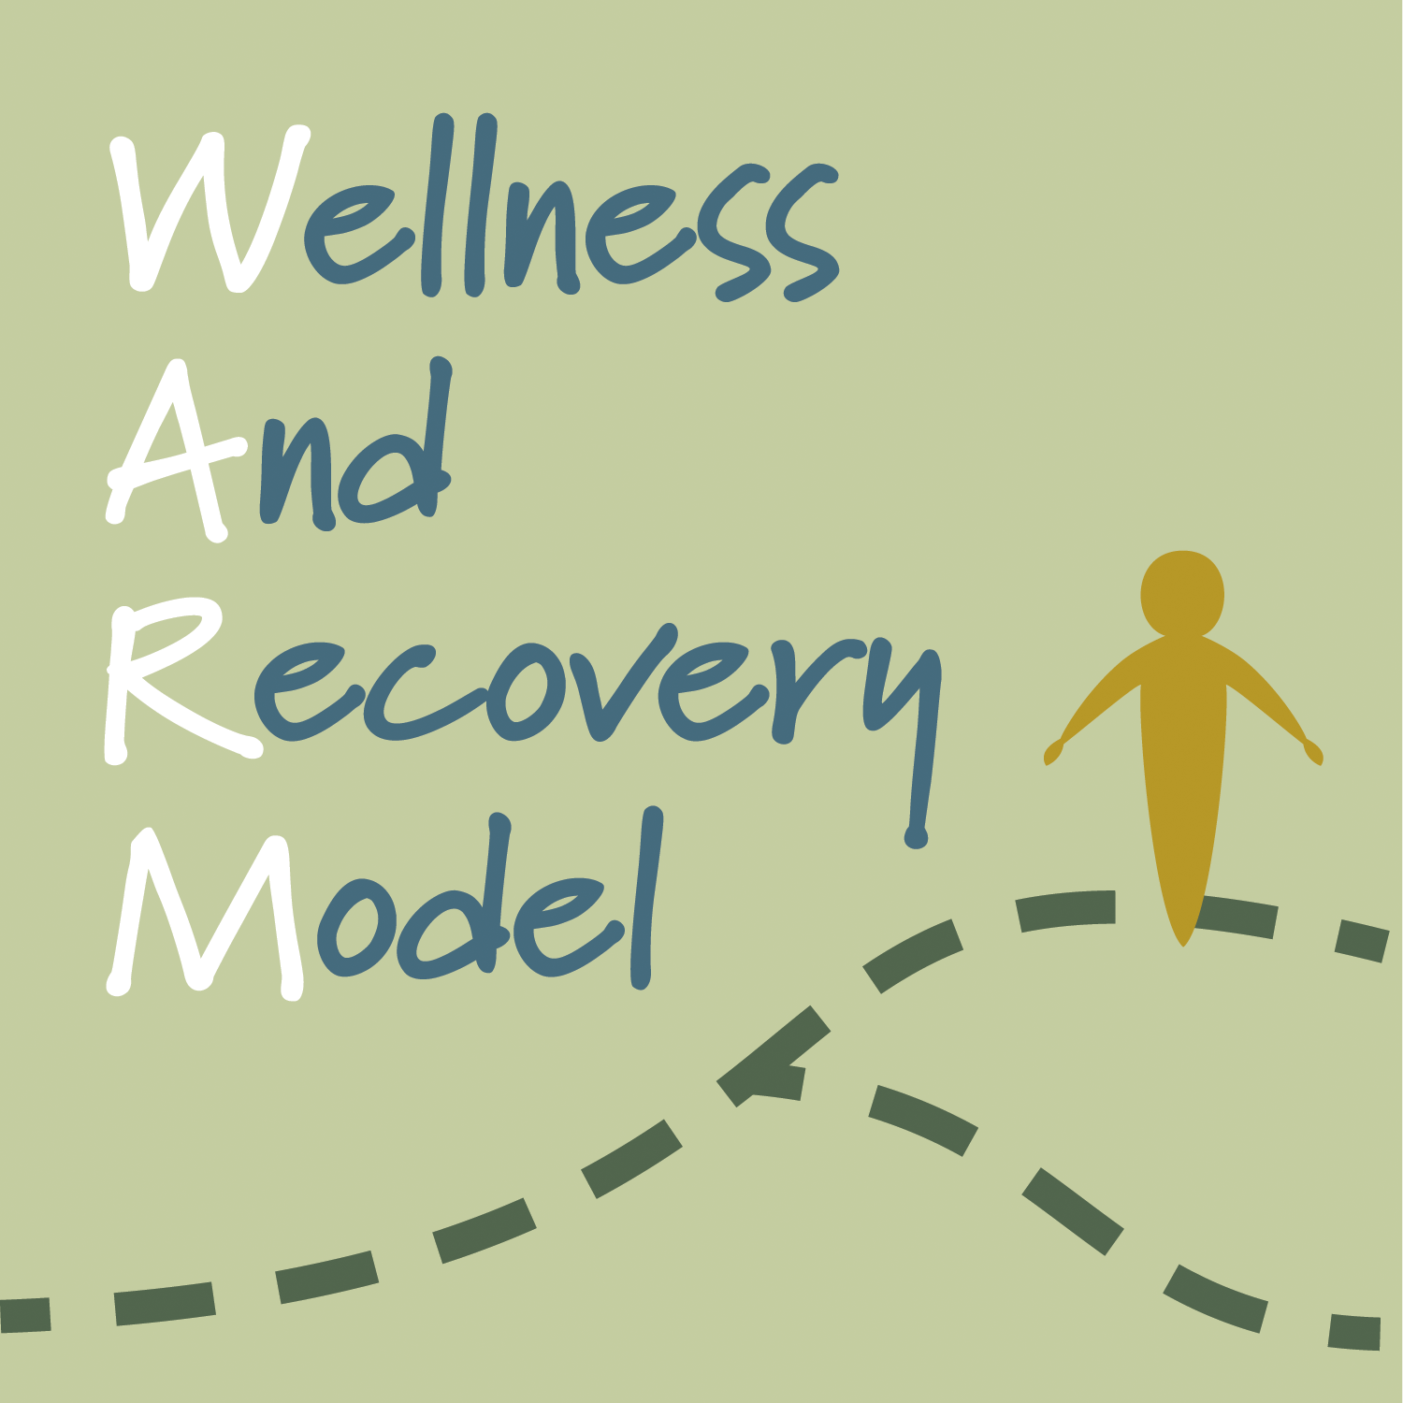
Wellness And Recovery Model (WARM)

Slide 22
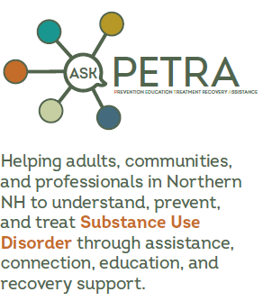
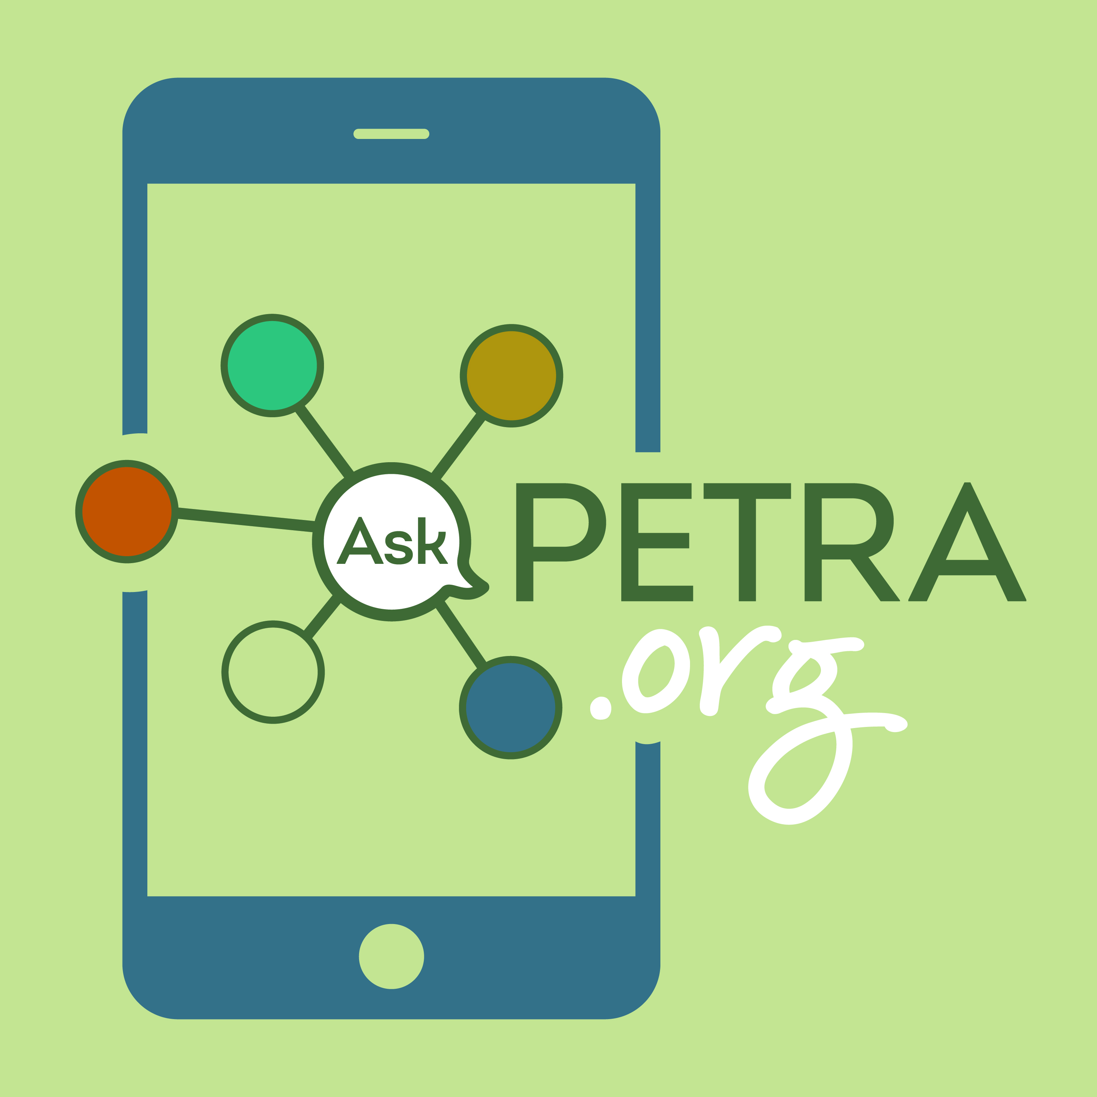
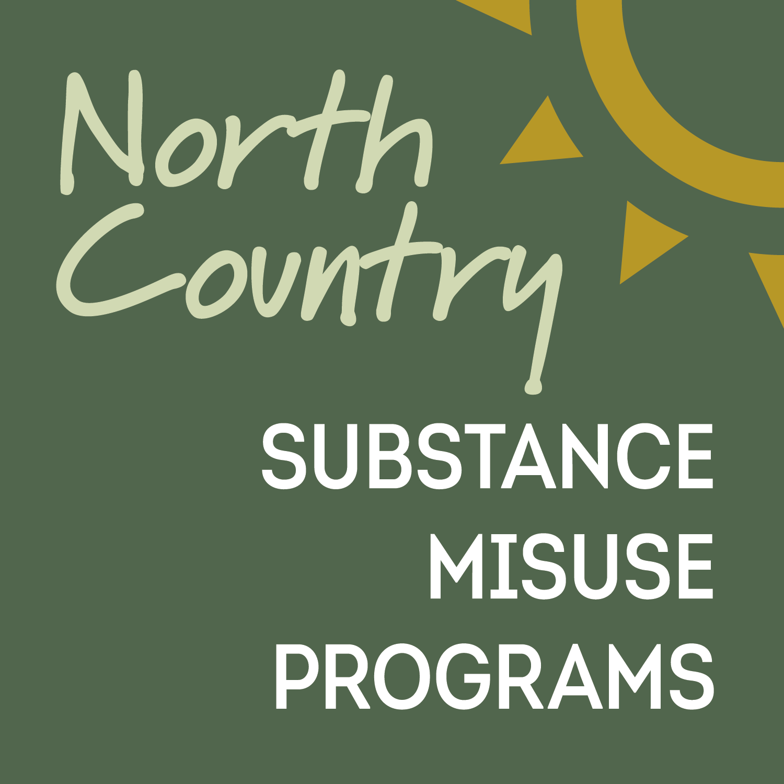
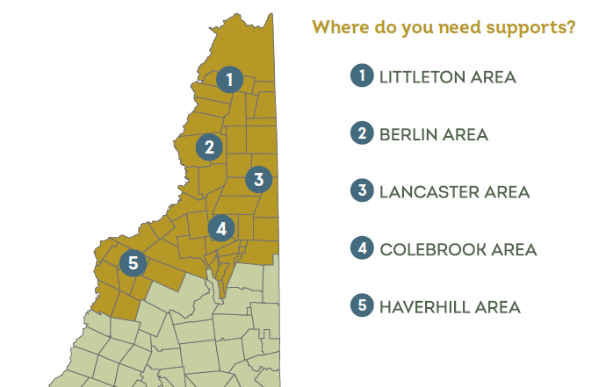
n

Slide 23
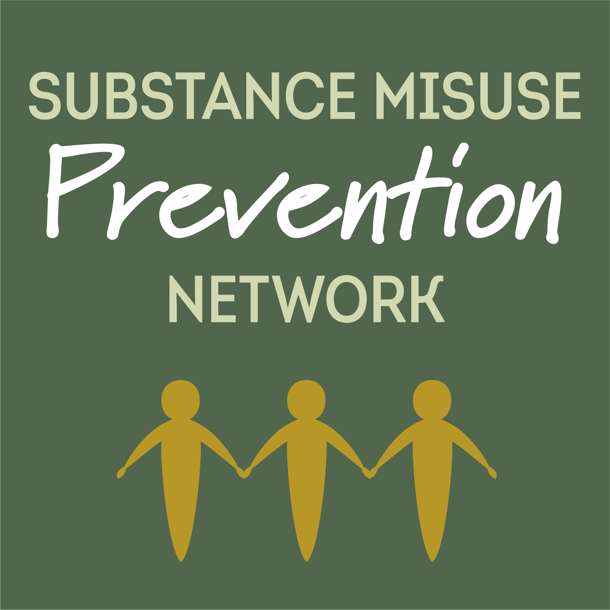
Substance Misuse Prevention Programs
Substance Misuse Prevention Network
Student Assistance Program
Continuum of Care
Drug Free Communities Support Program
Young Adult Strategies
Positive Youth Development

Slide 24
Regional Prevention Network
The North Country Regional Prevention Network for the prevention and reduction of substance misuse is a coordinated system made up of community stakeholders who lead, plan, support, monitor, and carry out prevention efforts in the North Country communities.

Slide 25
Student Assistance Program
The Goal of the Student Assistance Program (SAP) is to deliver Prevention Education relevant to Substance Misuse with the intent of decreasing risk behaviors and strengthening protective factors that exist in schools, communities and homes. NCHC supports SAPs in many school districts in northern NH.

Slide 26
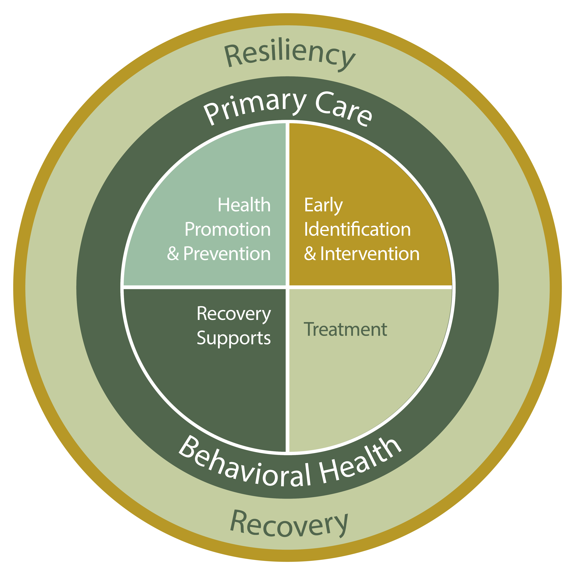
Continuum of Care Program
The Goal of the Continuum of Care (CoC) Program is to connect partners throughout the region to improve awareness, bridge gaps in services, and develop and maintain a regional continuum-of-care plan tailored especially for the people of the North Country.

Slide 27
Drug Free Communities (DFC) Program
“The Haverhill Area Substance Misuse Prevention Coalition mission is to reduce and prevent substance abuse among youth by working together to build a healthy, safe, and drug-free community.”
Goal #1 – Increase Community Collaboration
Goal #2 – Reduce Youth Substance Use

Slide 28
Youth Activities
To develop and support a state-endorsed Promising Practice program to support healthy, chem-free lifestyles among North Country middle and high school youth – Youth Leadership Through Adventure.
Empower youth to provide leadership, self-governance and to promote the benefits of a healthy substance-free lifestyle in their schools and communities.
Work to change community norms and culture where healthy substance-free lifestyles are promoted.

Slide 29
Young Adult Strategies
To lower substance use in the target population, young adults between 18-25 years.
Engage 18-25 Workforce and their employers.
Increase awareness and therefore access to Prevention, Treatment, Recovery and Support Services in the area.
Increase overall health knowledge of target population.
Reduce alcohol use - binge drinking, perceptions, motivation to reduce use, and coping with substances.
Gather relevant data on 18-25 cohort and measure.

Slide 30
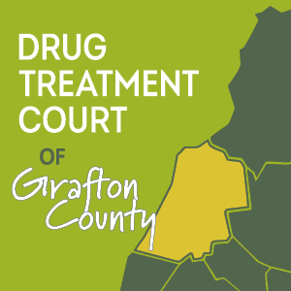
Drug Treatment Court of Grafton County
The mission of the Drug Treatment Court program of Grafton County is to assist criminal offenders in breaking the cycle of crime and substance misuse, while improving community safety, and decreasing financial costs currently incurred by the criminal justice system.
Within an 18- to 36-month window, each part of the multi-phase intervention program focuses on key concepts of addiction recovery, from stabilization to continuing care.
DTC works with its participants to determine the appropriate level of care needed and is aimed at supporting participants to maintain a drug-free lifestyle.

Slide 31
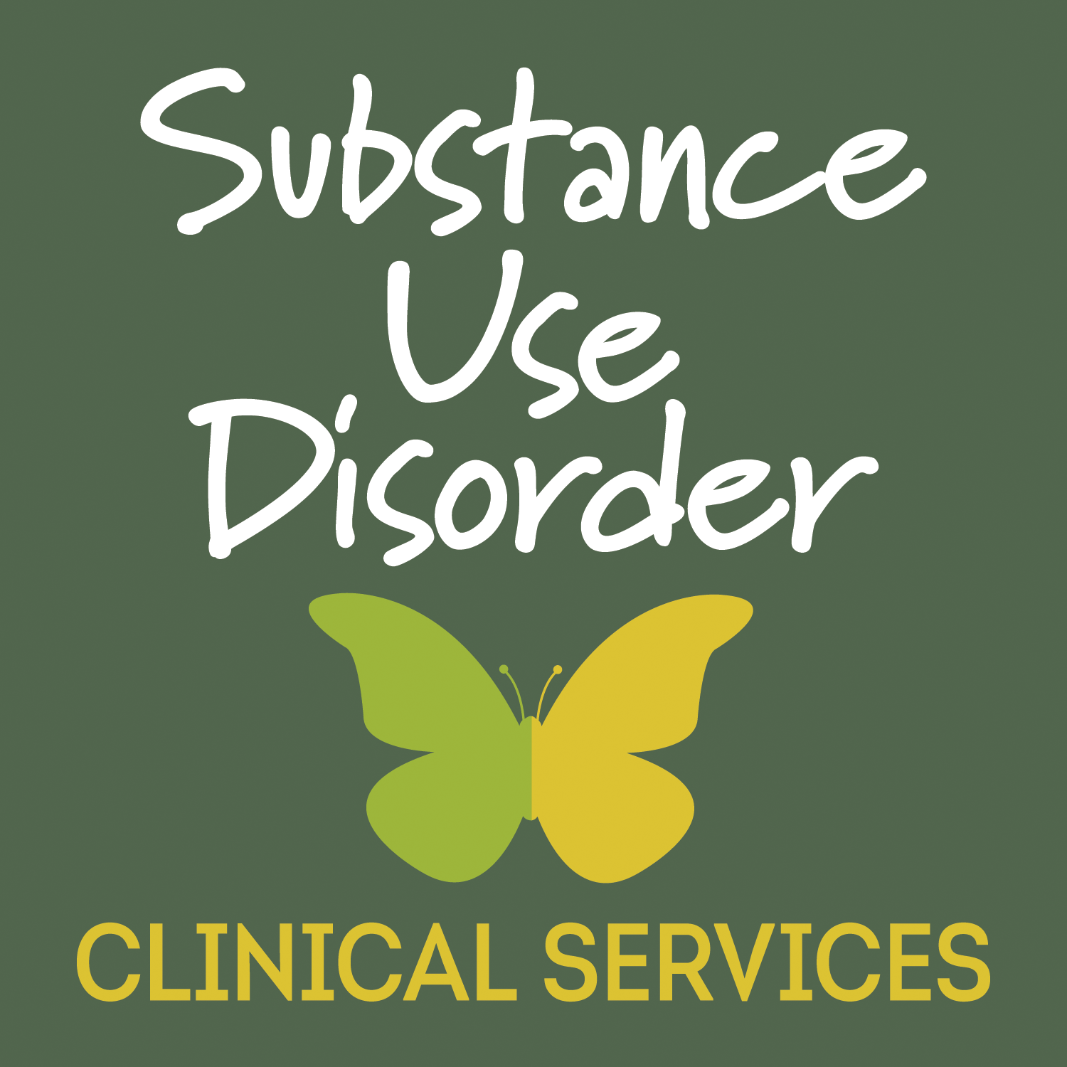
Substance Use Disorder Clinical Services
NCHC was awarded a three-year accreditation for its Residential, Intensive Outpatient, and Outpatient Substance Use Disorder Treatment programs by the Commission on Accreditation of Rehabilitation Facilities (CARF), an international accreditor of health and human services providers. It’s decision to designate three years to the Consortium represents the highest level of accreditation that can be granted to an organization.
As described on it’s website, “The CARF accreditation process starts with an organization’s commitment to continuous improvement and culminates with external review and recognition that the business and service practices meet international standards of quality–with all the steps in between focused on optimal outcomes for the persons served and sustained organizational success.”

Slide 32
For more information please visit our website at: NCHCNH.org

